Slide 1

Hyperparameter Tuning and AutoML with Optuna & FLAML
Exploring efficient methods for optimal machine learning performance
Notes:
AI-generated content may be incorrect. --- This presentation will cover advanced techniques for hyperparameter tuning using Optuna and AutoML with FLAML. We will explore the significance of hyperparameters, delve into Optuna's features, and examine FLAML's efficiency in automating machine learning processes.

Slide 2

Agenda
Introduction to Hyperparameter Tuning
Optuna: An Efficient Hyperparameter Optimization Framework
Using Optuna for Hyperparameter Tuning
Introduction to AutoML and FLAML
Notes:
We will start with an introduction to hyperparameter tuning, discussing its importance and challenges, followed by traditional methods. Then, we will explore Optuna, its functionalities, and how to implement it for hyperparameter optimization. Next, we'll introduce AutoML and FLAML, before diving into the implementation of FLAML. Finally, we'll discuss how to combine both Optuna and FLAML for improved performance.

Slide 3
Introduction to Hyperparameter Tuning
Notes:
Hyperparameter tuning is a crucial aspect of machine learning that can significantly influence model performance. It involves selecting the best set of hyperparameters to optimize a model's performance on a given task.

Slide 4

Definition and importance of hyperparameters
What are Hyperparameters?
Hyperparameters are configurations that are set prior to training a machine learning model, affecting how the model learns.
Role in Training Process
They play a crucial role in guiding the training process, affecting model accuracy and efficiency.
Impact on Model Performance
Choosing hyperparameters wisely can enhance model performance, while poor choices can cause overfitting.
Notes:
Hyperparameters are parameters that are set before the learning process begins and govern the training process. They are essential as they guide the model's learning journey and can lead to better performance or overfitting if chosen poorly.

Slide 5
What is the difference between Parameters and Hyperparameters of a model?

Slide 6
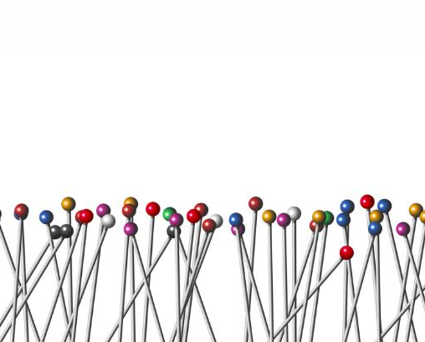
Challenges in Hyperparameter Tuning
Vast Search Space
The sheer number of hyperparameter combinations makes it difficult to find the optimal settings for models.
Computational Cost
Training models with different hyperparameter configurations can be resource-intensive, requiring significant computational power.
Overfitting Risks
Too much focus on tuning can lead to overfitting, where the model performs well on training data but poorly on unseen data.
Time-Consuming Process
Hyperparameter tuning often requires substantial time and effort, making it a significant bottleneck in the modeling process.
Notes:
Hyperparameter tuning can be challenging due to the vast search space of possible values and the computational cost involved in training models for different hyperparameter configurations.

Slide 7
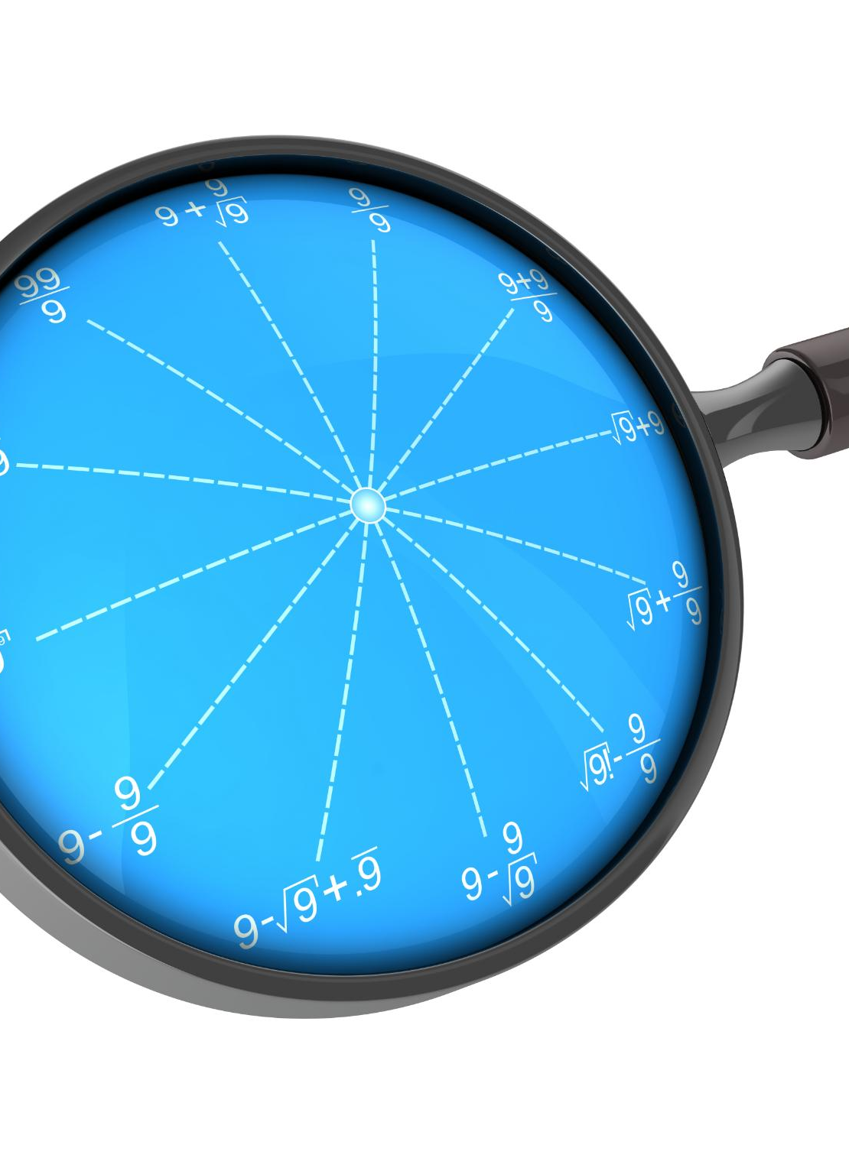
Traditional Tuning Methods
Grid Search Method
Grid search involves exhaustively searching through a specified subset of hyperparameters, making it systematic but potentially slow.
Random Search Method
Random search samples hyperparameters randomly, providing a more efficient alternative, particularly in high-dimensional spaces.
Notes:
Traditional methods for hyperparameter tuning include grid search and random search. While effective, these approaches can be inefficient, especially in high-dimensional spaces.

Slide 8
Optuna: An Efficient Hyperparameter Optimization Framework
Notes:
Optuna is an automatic hyperparameter optimization framework designed to optimize machine learning models efficiently. It offers a flexible and intuitive interface for defining and optimizing hyperparameters.

Slide 9
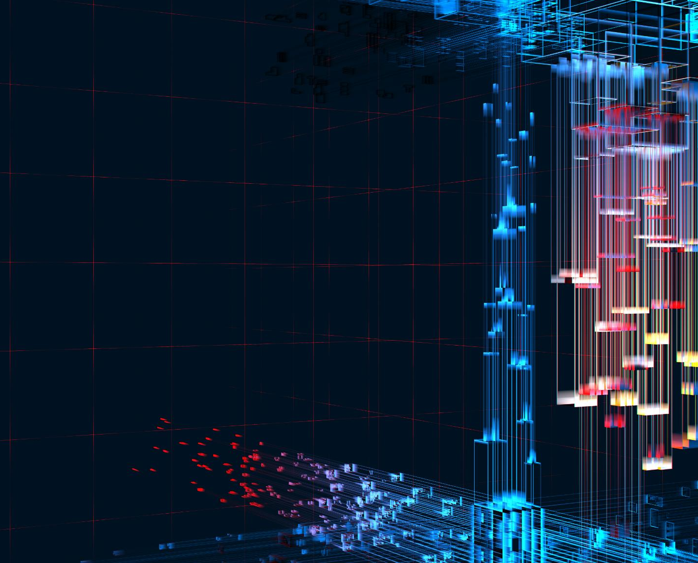
Overview of Optuna
Optimization Objectives
Optuna enables users to define specific optimization objectives tailored to their needs, enhancing the effectiveness of their solutions.
Support for Algorithms
Optuna supports a variety of optimization algorithms, making it versatile for different types of optimization tasks.
Ease of Use
Known for its user-friendly interface, Optuna simplifies the optimization process for users of all skill levels.
Handling Complex Search Spaces
Optuna is efficient in managing complex search spaces, allowing for thorough exploration and optimization.
Notes:
Optuna allows users to define optimization objectives and supports various optimization algorithms. It is particularly known for its ease of use and ability to handle complex search spaces.

Slide 10

Key features and advantages
Automatic Pruning
Optuna's automatic pruning feature helps eliminate unpromising trials early, saving computational resources and time.
Parallel Execution
The ability to execute multiple trials in parallel significantly speeds up the hyperparameter optimization process, enhancing efficiency.
Various Sampling Methods
Optuna offers various sampling methods to explore the hyperparameter space more effectively, leading to better performance.
Notes:
Optuna features include automatic pruning of unpromising trials, parallel execution, and the ability to use various sampling methods. These features help in efficiently finding optimal hyperparameters.

Slide 11
Using Optuna for Hyperparameter Tuning
Notes:
Once Optuna is set up, it can be used effectively for hyperparameter tuning in various models. The process involves defining an objective function and selecting appropriate optimization algorithms.

Slide 12
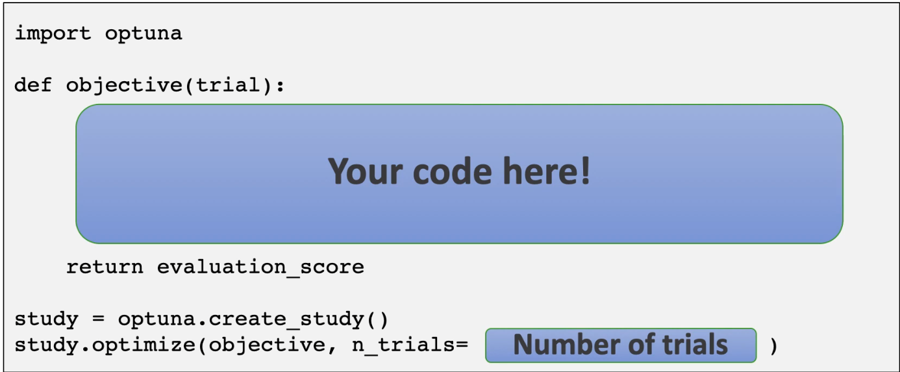
Defining an objective function
Importance of Objective Function
The objective function plays a pivotal role in model optimization by evaluating performance based on hyperparameters.
Performance Evaluation
It assesses how well the model performs, providing essential feedback for the optimization process.
Guiding Optimization Process
The feedback from the objective function guides the choice of hyperparameters during optimization.
Notes:
An objective function is crucial in Optuna as it evaluates the performance of the model based on the current hyperparameters. It provides feedback that guides the optimization process.

Slide 13

Optimization algorithms in Optuna
TPE Algorithm (default)
The Tree-Structured Parzen Estimator (TPE) is a popular optimization algorithm used in Optuna for efficient hyperparameter tuning.
It models the performance of hyperparameters as a probability distribution: P(hyperparameters|score)
TPE focuses on promising areas of the hyperparameter space, improving efficiency.
It compares two distributions: one for good performance and one for bad.
The algorithm iteratively refines the search based on past evaluations.
Others: Covariance Matrix Adaptation Evolution Strategy (CMA-ES); Random Search; Grid Search
Notes:
Optuna supports several optimization algorithms like TPE (Tree-Structured Parzen Estimator) and CMA-ES (Covariance Matrix Adaptation Evolution Strategy), allowing users to choose the best fit for their problem.

Slide 14

Visualizing and interpreting results
Optimization Visualization Tools
Optuna offers various tools to visualize optimization progress, aiding in the understanding of hyperparameter impacts.
Impact of Hyperparameters
Visualizations help interpret how different hyperparameters affect model performance and search efficiency.
Efficiency of Search Process
Understanding the efficiency of the search process is crucial for optimizing machine learning models effectively.
Notes:
Optuna provides tools for visualizing optimization progress and results, which help in understanding the impact of hyperparameters and the efficiency of the search process.

Slide 15
Introduction to AutoML and FLAML
Notes:
AutoML aims to automate the end-to-end process of applying machine learning to real-world problems. FLAML (Fast and Lightweight AutoML) is a framework that seeks to enable efficient AutoML with an emphasis on low resource consumption.

Slide 16

What is AutoML?
Automation of Machine Learning
AutoML automates various machine learning tasks, streamlining the process and reducing manual effort needed.
Data Preprocessing
AutoML simplifies data preprocessing tasks, enabling users to prepare data efficiently without expert knowledge.
Feature and Model Selection
AutoML assists in feature selection and model selection, making it easier for non-experts to choose the best options.
Hyperparameter Tuning
AutoML automates hyperparameter tuning, optimizing model performance without requiring deep technical skills.
Notes:
AutoML refers to systems that automate the tasks of applying machine learning, including data preprocessing, feature selection, model selection, and hyperparameter tuning, making machine learning accessible to non-experts.

